Slide 1

Information security

Slide 2
Information security & its requirements

Slide 3
Information security
everything starts here
CIA requirements
other (non-secondary) requirements
what is a requirement?
safety vs. security

Slide 4
Requirements
Confidentiality
Integrity
Availability
Authentication
Non-repudiation
Accounting
Standard in ISO 27000

Slide 5
Cryptography vs. security
Cryptography and security differ
Cryptography traditionally deals with secrecy of information
Most real security deals with problems of fraud:
Message modifications
User authentication
Much of security has little to do with encryption however it might use cryptography
Almost invariably, encryption does not live alone without some form of authentication

Slide 6

Pre-computer cryptography
an overview on old cryptography
old = before computers exist

Slide 7
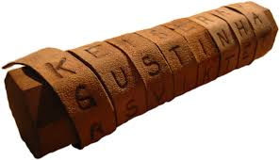
Scytale cipher
Sparta, 700 BCE
a strip of parchment was wrapped around a wooden rod, and the message was written lengthwise
to decrypt, recipient needed a rod of same diameter

Slide 8

The Egyptian pharaoh approach
The sender
Shaving a slave's head
Carving the secret message into the skull
Waiting for the hair to grow back
Sending the slave to the recipient
The recipient
Knows he must shave slave's head
After that, he could access the message
Timescales not comparable to today's

Slide 9
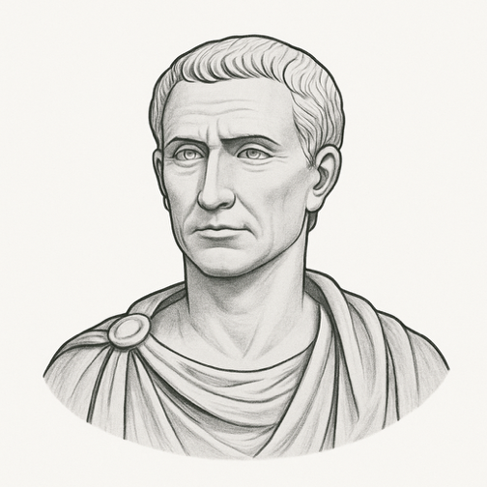
Caesar cipher
Shift the alphabet by a predetermined number of positions (e.g. 3)
A | B | C | D | E | … | W | X | Y | Z
C | D | E | F | G | … | Z | A | B | C
key = 3
attack: it is sufficient to test all possible keys (26)

Slide 10
Alphabetic substitution
A | B | C | D | E | … | W | X | Y | Z
D | U | Z | O | L | … | Y | B | A | R
random permutation (26! = 403 291 461 126 605 635 584 000 000)
attack: use a computer for a frequency attack

Slide 11
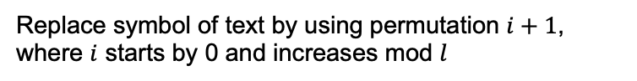
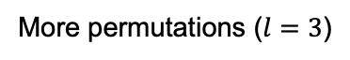
Polyalphabetic
if long enough frequency analysis still effective
More permutations ($l=3$)
A | B | C | D | E | … | W | X | Y | Z
D | U | Z | O | L | … | Y | B | A | R
B | P | Y | Q | M |  | T | Z | S | N
W | P | Q | L | A |  | S | L | F | G
0
1
2
3
Replace symbol of text by using permutation $i+1$, where $i$ starts by 0 and increases mod $l$

Slide 12
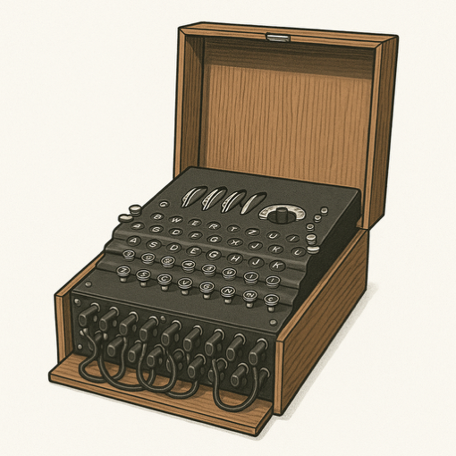
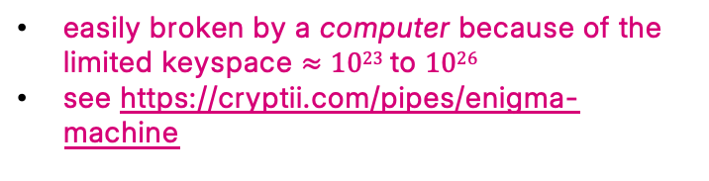
Enigma
one of the most advanced ciphers among the ancients (WWII)
it encrypted each letter by passing it through a series of rotating electrical rotors, producing a different substitution with every keystroke
broken by allied at Bletchley Park
easily broken by a computer because of the limited keyspace $≈1023$to $1026$
see https://cryptii.com/pipes/enigma-machine

Slide 13

Conclusion
Many other examples are possible
In all examples sender and recipient must share some information
We call this shared information the Key (still today)

Slide 14
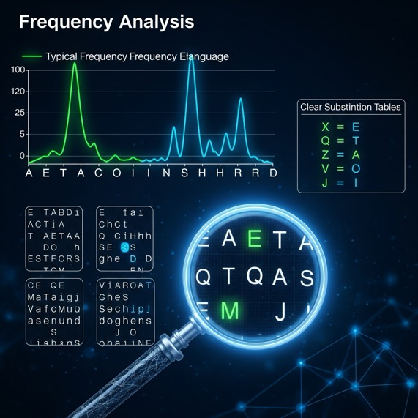
Frequency analysis
cryptoanalysis by frequency analysis
uses computers

Slide 15
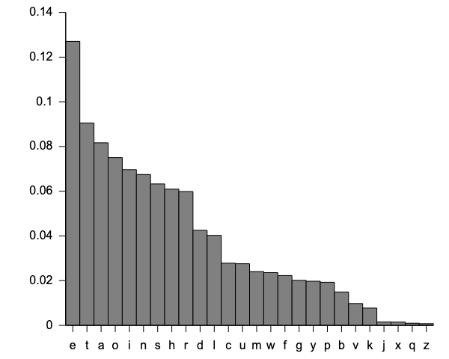
Frequency of letters
Each language has its own distribution of frequencies of the letters used
they change from language to language but are public and well-known (Wikipedia)
English

Slide 16
Languages
How to obtain frequencies
They are typically public and available on the web
Several online resources exist
How to do it yourself
Take a large sample of text
Remove spaces, punctuation, and special symbols
Sort the remaining sequence of letters
Perform a simple block-based count

Slide 17
Frequency analysis (simplified)
Clean encrypted text
Normalize casing (all lowercase or uppercase)
Compute basic frequencies
Count the frequency of each individual character

Slide 18
Frequency analysis (simplified) (2)
Use known frequency profiles from major languages
Language | Most frequent letters
English | E, T, A, O, N, I
French | E, A, S, I, T
Spanish | E, A, O, S, N
German | E, N, I, S, R, A
Italian | E, A, I, O, N
Try aligning the most frequent letters of the encrypted text to each of these and see which language yields the most plausible results

Slide 19
Frequency analysis (simplified) (3)
Doesn’t work well on
short messages
polyalphabetic ciphers
modern encryption
Look for language-specific patterns
common letter pairs (like TH, QU, CH, LL) or letter positions (e.g., Q followed by U is common in many languages)
common word lengths (e.g., 2-letter words in English: it, is, to)
repeated short patterns like la, le, de (Romance languages), or endings like -en, -er (Germanic languages)

Slide 20
Model of encryption
used and accepted in all environments

Slide 21
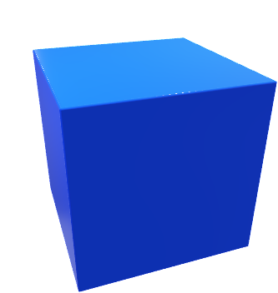



Model
12 aprile 2023
IASD
if keys $K1 = K2$symmetric encryption
else asymmetric
Bob
$$K1$$
$$K2$$
plaintext
ciphertext
plaintext
encryptor
decryptor
Alice
for confidentiality symmetric encryption is preferred

Slide 22

What is a key?
(Long) string of (random) bits
All strings should have same probability
010100011101011101010101101010…
symmetric keys must remain confidential

Slide 23
Communication model
Alice
Bob
Two parties – Alice and Bob
Reliable communication line
Shared encryption scheme: E, D, K₁, K₂
Goal: send a message M confidentially

Slide 24
Threat (attack) model
Alice
Bob
Trudy
(or Eve)
adversary
attack to confidentiality: get partial/total information on M
Cybersecurity d'Amore 01
24

Slide 25
Adversary
Passive
reads the exchanged messages
(no change)
Active
can modify messages sent by Alice or Bob
can send false (fake) messages claiming that they have been sent by someone else

Slide 26
Terminology
term | meaning
plaintext | information that will be encrypted
ciphertext | information that has been encrypted, i.e. transformed into incomprehensible text
key | sequence of fixed length of bits that appear random; in the symmetric case K₁ = K₂
cipher | pair of algorithms for encryption and decryption, often denoted as (E, D)
encryptor | entity that applies a cipher (algorithm E), producing a ciphertext
decryptor | entity that applies a cipher (algorithm D), producing a plaintext
encryption | the operation performed by an encryptor
decryption | the operation performed by a decryptor
adversary | entity that attempts to compromise confidentiality, integrity, or availability of information systems

Slide 27
Security goals
Kerckhoff's principle: a cryptosystem should be designed to be secure, even if all its details, except for the key, are publicly known
If the keys are unknown, then
- it is hard to obtain even partial information on the message
- it is hard to find the key even if we know clear text
hard = computationally hard: it takes long time even if the most powerful computers are available
Shannon’s maxim: the enemy knows the system
27

Slide 28
Adversarial model
Trudy attempts to discover information about M
Trudy knows the algorithms E, D
Trudy knows the message space
Trudy has at least partial information about ciphertext
Trudy does not know K₁, K₂
28

Slide 29

Attack categories
against confidentiality and other requirements of information security

Slide 30
What is in attack?
Any intentional attempt to compromise the security of a computer system, network, or data by violating one or more core principles of information security, such as confidentiality, integrity, or availability
Some attacks do not directly target information security principles but serve indirect purposes, such as enabling future compromise or gathering intelligence
Remember, cryptography plays a fundamental role among the measures designed to uphold information security

Slide 31
First attacks
type | acronym | description
Eavesdropping | — | secretly listening to private conversation of others without their consent
Ciphertext-only attack | COA | attacker has only access to ciphertexts and tries to deduce the plaintext or key
Known-plaintext attack | KPA | attacker knows pairs of plaintext and ciphertext and uses them to infer the key
Chosen-plaintext attack | CPA | attacker can encrypt arbitrary plaintexts to gather information about the cipher
Chosen-ciphertext Attack | CCA | attacker can decrypt arbitrary ciphertexts of their choice, except for the target ciphertext

Slide 32
Attacks may use an oracle
An oracle is a theoretical black-box function that an attacker can query to obtain outputs (e.g., ciphertexts or plaintexts), often under controlled conditions
It is an abstract entity or mechanism that provides access to a cryptographic function without revealing its internal workings

Slide 33
Selection of attacks
Known plaintext: attacker has samples of both plaintext and its encrypted version (ciphertext) and is at liberty to make use of them to reveal further secret information such as secret keys
Chosen plaintext: attacker has the capability to choose arbitrary plaintexts to be encrypted and obtain the corresponding ciphertexts. The goal of the attack is to gain some further information which reduces the security of the encryption scheme. In the worst case, a chosen-plaintext attack could reveal the scheme's secret key
uses an oracle

Slide 34
Selection (continued)
Chosen ciphertext: the cryptanalyst gathers information, at least in part, by choosing a ciphertext and obtaining its decryption under an unknown key
Adaptive chosen plaintext: the cryptanalyst makes a series of interactive queries, choosing subsequent plaintexts based on the information from the previous encryptions
both use an oracle

Slide 35
Other attacks
type | description
Cryptoanalysis | Any mathematical technique used to break or weaken cryptographic algorithms
Brute-force attack | Attacker tries all possible keys until the correct one is found
Side-channel attack | Exploits physical data (timing, power consumption, EM radiation) from a device
Replay attack | Reuses previously captured valid messages to trick a system
Man-in-the-middle attack (MITM) | Attacker intercepts and potentially alters communications between two parties
more attacks discussed next

Slide 36
About brute-force
Modern computers can quickly try exploring all possible keys (~ 10⁶ to 10¹⁵ keys/second)
depending on hardware
Keys often have a fixed size: the longer the key, the stronger the security — but the slower the performance
If a key is n bits long, there are 2ⁿ possible keys. The practical limit for current computers is often set around n = 80, but this threshold continues to rise. With 128-bit keys, even at a rate of 1 trillion keys per second, it would take over 10¹⁹ years on average to brute-force the key

Slide 37
Keys and password
similar but different

Slide 38
Why to make a distinction?
Keys and passwords
They have similarities but are different
Both are secret
Cryptography uses both (for now)
They have different characteristics
They are used in different contexts
They are protected differently
They have a different impact on security

Slide 39
Password basics
A password is a human-chosen secret used to authenticate a user
It must be
Memorable
Short enough to type
Representable with keyboard characters

Slide 40
Limitations of passwords
Typable = predictable: constrained to the keyboard → lower entropy
Password space = Tⁿ, not Nⁿ (T: keyboard-typable symbols, N>T: all possible symbols)
Vulnerable to
Brute force
Reuse across platforms
Other attacks

Slide 41
Phishing attacks
Phishing is a type of social engineering attack in which an adversary tricks users into revealing sensitive information, such as passwords, credit card numbers, or access credentials
Characteristics
Disguised as legitimate emails, messages, or websites
Often creates urgency (e.g., “Your account will be locked!”)
Can lead to credential theft, financial loss, or malware installation
Email, SMS, voice calls, fake login pages etc.
other vulnerabilty of passwords

Slide 42
What is a cryptographic key?
A cryptographic key is a random bit string used in encryption, decryption, and other cryptographic operations
If the string is n bits long, then there are 2ⁿ possible keys
0101011000011101…10101011
561D…AB (often represented in hexadecimal)

Slide 43
Key properties
Machine-generated
Not typable
Fixed-length (e.g., 128, 256 bits)
Stored as binary, not text
Visual Comparison
Password: S3cr3t!
Key: 9F4b713f8e2a... (256 bits)

Slide 44
Password vs Key – Comparison Table
feature | password | cryptographic key
chosen by | human | machine
typable | yes – must fit a keyboard | no – binary data
length | short (8–20 chars typically) | long (128–256 bits or more)
purpose | authentication | encryption / signing
stored as | hashed (ideally) | raw / protected

Slide 45
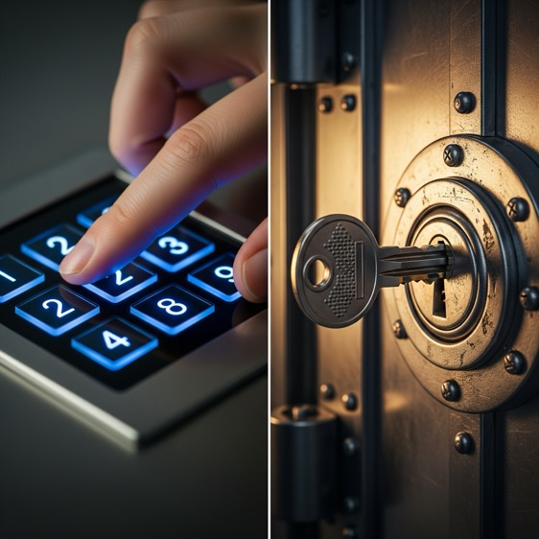
Analogy
password = PIN typed into a keypad
key = the actual metal key unlocking a vault

Slide 46
Combined use
Many systems use passwords to unlock secret keys
Example
PGP, Signal, WhatsApp: your password decrypts a stored secret key

Slide 47
Key Derivation
Passwords are often converted into keys using "ad hoc" algorithms
Argon2, PBKDF2
Still constrained by password entropy

Slide 48
Why keys are more secure
Higher entropy
Machine-random
Not guessable or typable

Slide 49
Why passwords are still used
Usable by humans
Don’t require special storage
Usability vs security tradeoff

Slide 50
Summary
Passwords: chosen by humans, typable, used for identity
Keys: generated by machines, not typable, used for encryption
They’re not interchangeable — both must be protected appropriately

